Slide 1

Binary Search Tree

Slide 2
What is BST ?
Binary Search tree can be defined as a class of binary trees, in which the nodes are arranged in a specific order. This is also called ordered binary tree.
In a binary search tree, the value of all the nodes in the left sub-tree is less than the value of the root.
Similarly, value of all the nodes in the right sub-tree is greater than or equal to the value of the root.
This rule will be recursively applied to all the left and right sub-trees of the root.

Slide 3
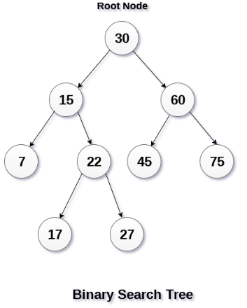
Example:

Slide 4
Advantages of BST
Searching become very efficient in a binary search tree since, we get a hint at each step, about which sub-tree contains the desired element.
The binary search tree is considered as efficient data structure when compared to arrays and linked lists.
In searching process, it removes half sub-tree at every step.
Searching for an element in a binary search tree takes o(log₂n) time. In worst case, the time it takes to search an element is 0(n).
It also speed up the insertion and deletion operations as compare to that in array and linked list.

Slide 5
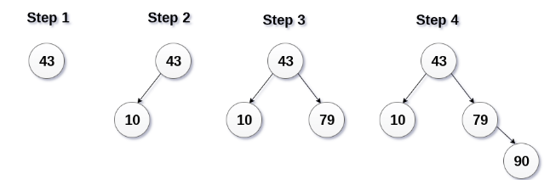
Creation of BST : An Example
Q) Create the binary search tree using the following data elements :
43, 10, 79, 90, 12, 54, 11, 9, 50

Slide 6
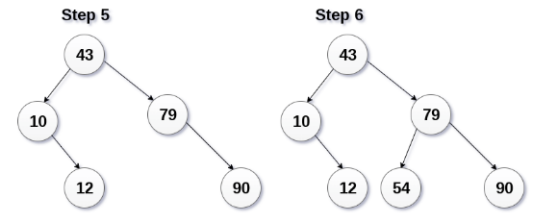
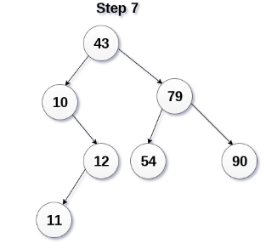
Contd…

Slide 7
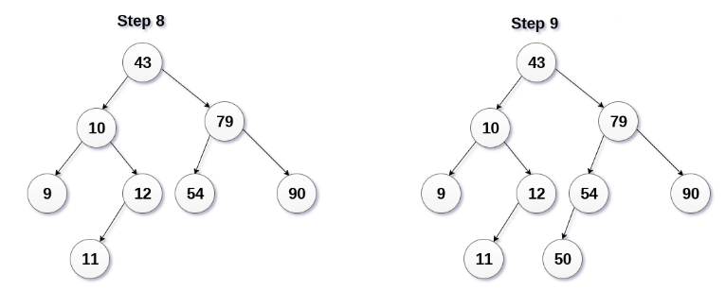
Contd..

Slide 8
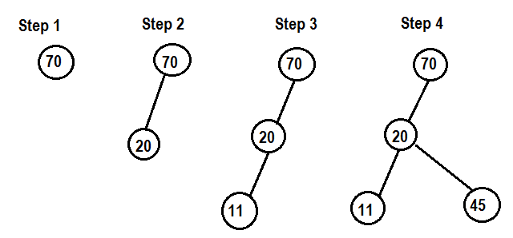
Creation of BST : An Example
Q) Create the binary search tree using the following data elements :
70,20,11,45,95,76,29,59,99

Slide 9
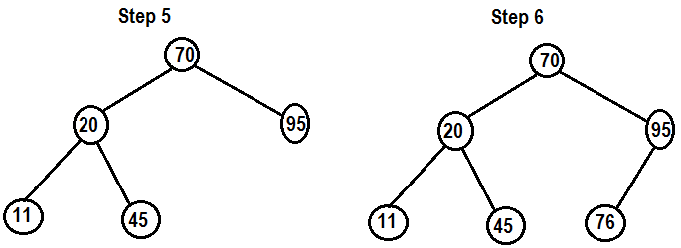
Contd..

Slide 10
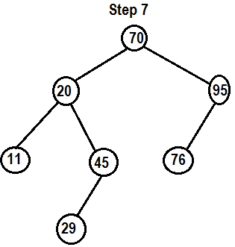
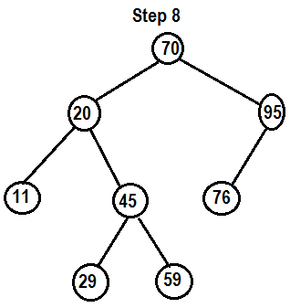
Contd..

Slide 11
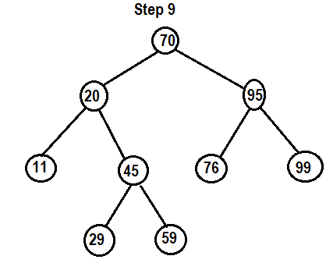
Contd..

Slide 12
Algorithm for Insertion into BST
INSERT_BST(ROOT,LEFT,RIGHT,INFO,ITEM,FRESH,PTR,PREV)
Step 1: Start
Step 2: Set FRESH:=AVAIL
Step 3: Display “Enter info part”
Step 4: Read ITEM
Step 5: Set INFO[FRESH]:=ITEM
Step 6: Set LEFT[FRESH]:=NULL
Step 7: Set RIGHT[FRESH]:=NULL
Step 8: If ROOT == NULL, Then
Step 8.1: Set ROOT:=FRESH
Step 9: Else
Step 9.1: Set PTR:=ROOT
Step 9.2: Repeat while (PTR!=NULL)
Step 9.2.1: If INFO[FRESH]<INFO[PTR], Then
Step 9.2.1.1: Set PREV:=PTR
Step 9.2.1.2: Set PTR:=LEFT[PTR]
Step 9.2.2: Else
Step 9.2.2.1: Set PREV:=PTR
Step 9.2.2.2: Set PTR:=RIGHT[PTR]
[End of If – Step 9.2.1]
[End of While – Step 9.2]

Slide 13
Algorithm for Insertion into BST( Cont..)
Step 9.3: If (INFO[FRESH]<INFO[PREV]), Then
Step 9.3.1: Set LEFT[PREV]:=FRESH
Step 9.4: Else
Step 9.4.1: Set RIGHT[PREV]:=FRESH
[End of If – Step 9.3]
[End of If – Step 8]
Step 10: Stop

Slide 14

THANK YOU

